Slide 1
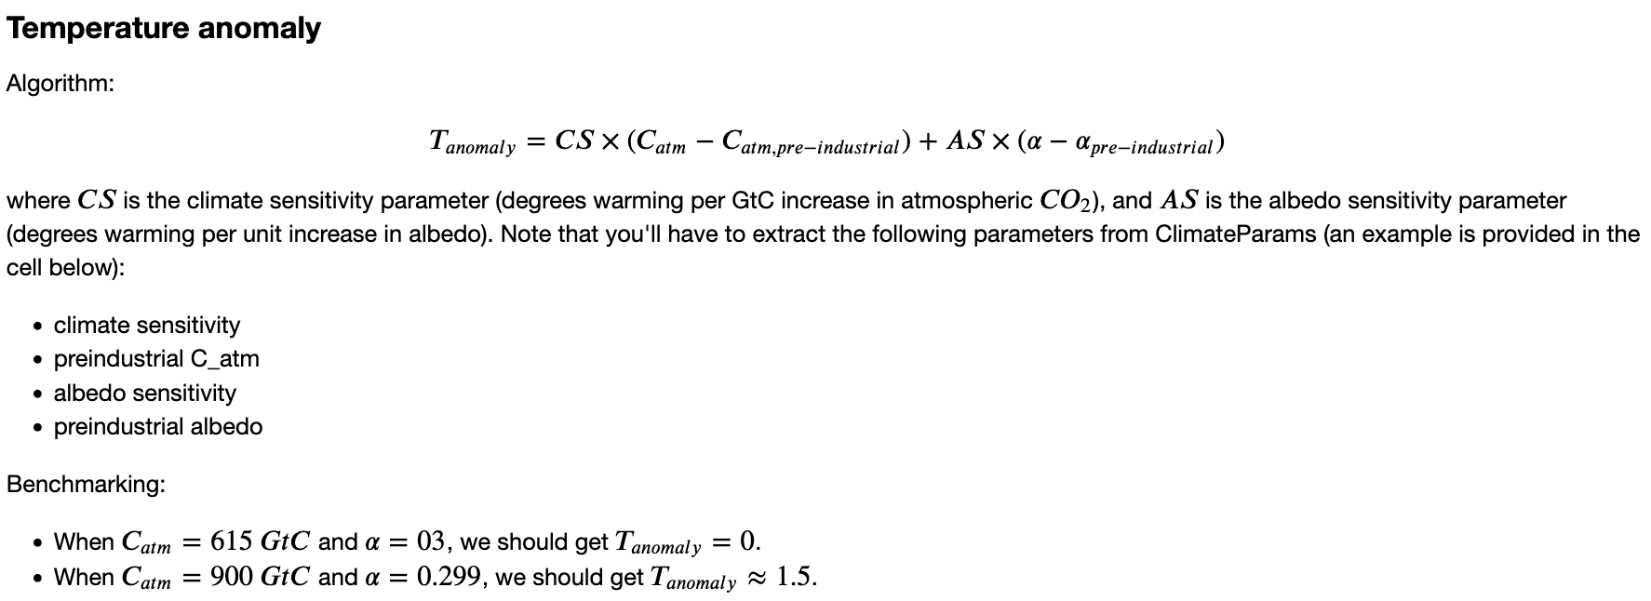




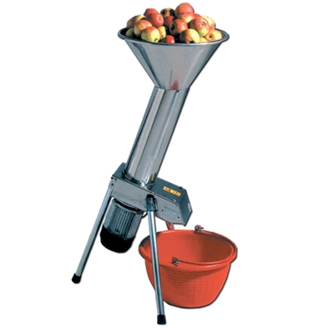

Recap: In DiagnosticFunctions, we worked on making Python functions

Slide 2
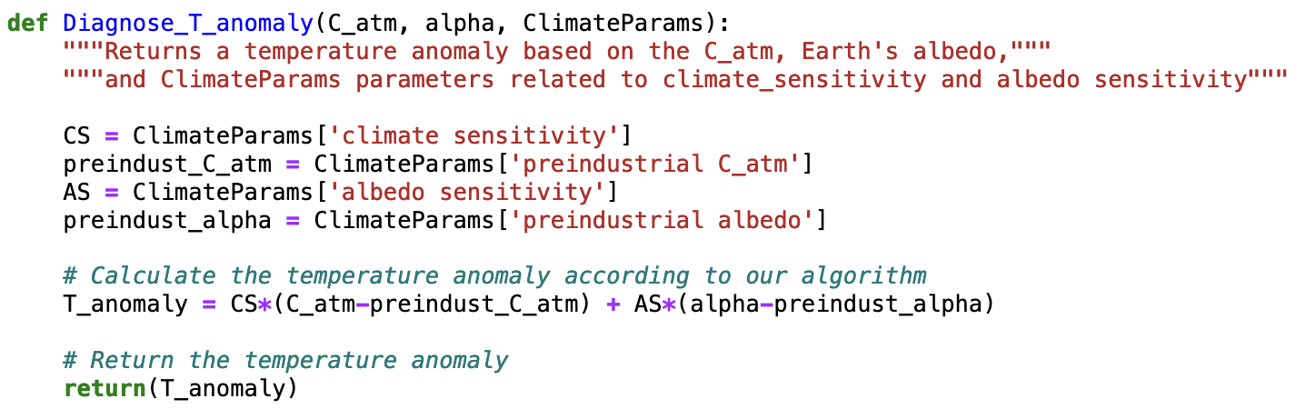
Recap: In DiagnosticFunctions, we worked on making Python functions

Slide 3
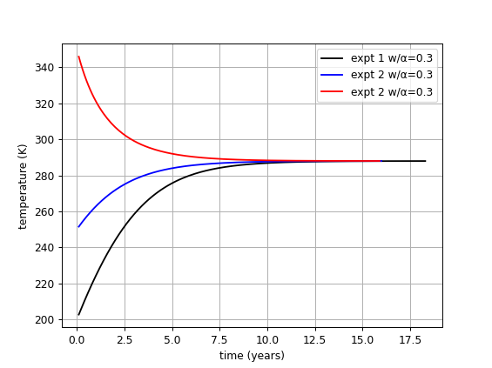
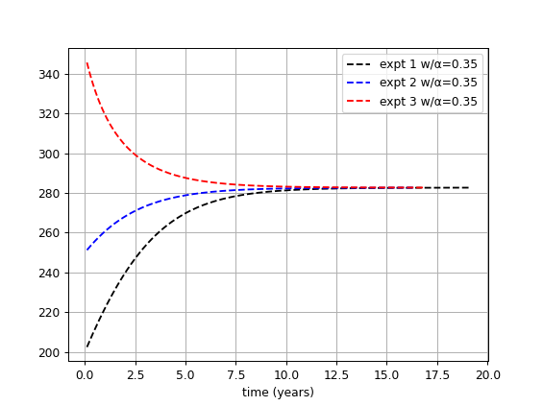


Recap: In DiagnosticFunctions, we worked on making Python functions
Albedo sensitivity (AS) = how much Earth’s steady-state temperature changes when we change its albedo
Climate sensitivity (CS) = slope of the orange line
$$T_{anomaly}$$
$${[C}_{atm}]$$

Slide 4
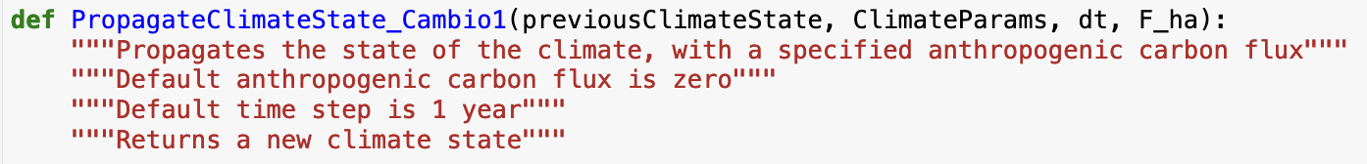




Introducing a climate propagator too
…

Slide 5

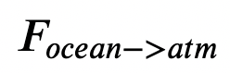
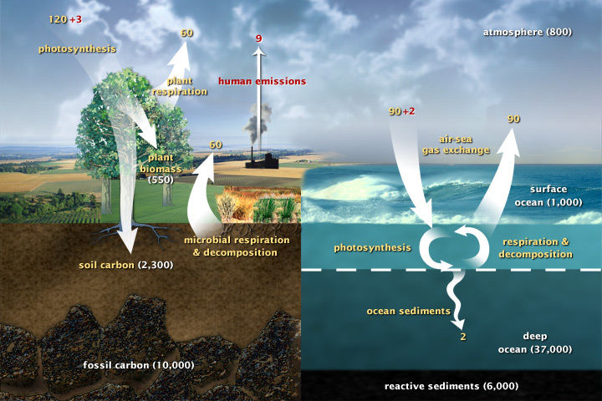
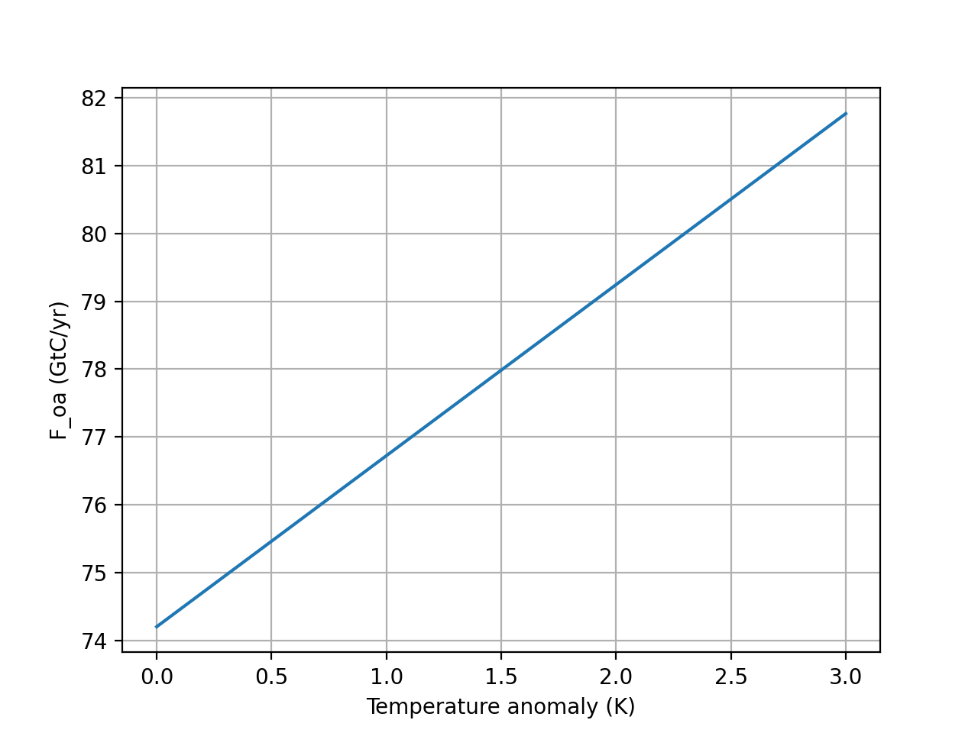


Recap: in Cambio 2.0, we use $T_{anomaly}$to take into account the Henry effect
$$F_{ocean→atm}=k_{oa}×(1+T_{anomaly}×DC)[C_{ocean}]$$
This is the Henry effect, whereby gases are less soluble in warmer oceans.
Cold ocean
Warm ocean
$$F_{ocean→atm}$$
$$T_{anomaly}$$

Slide 6
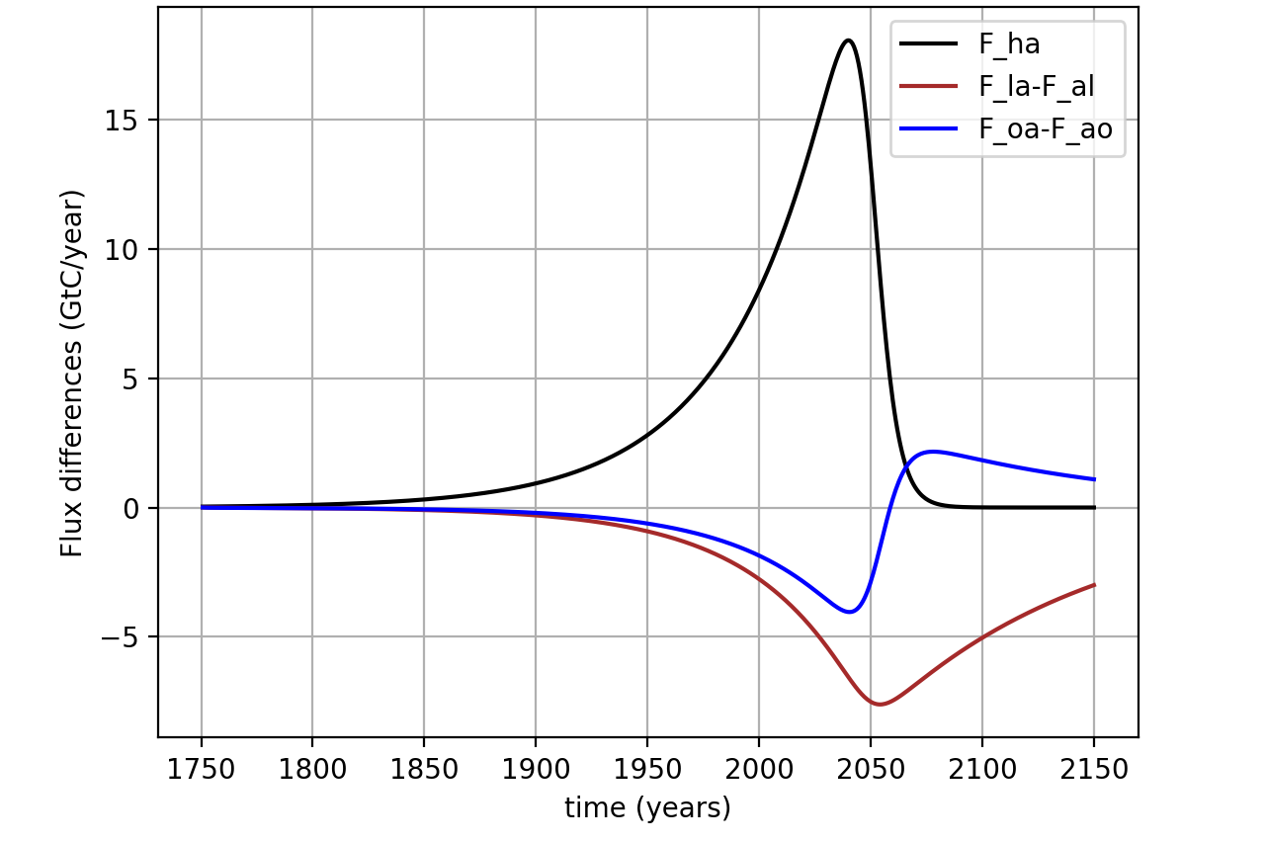

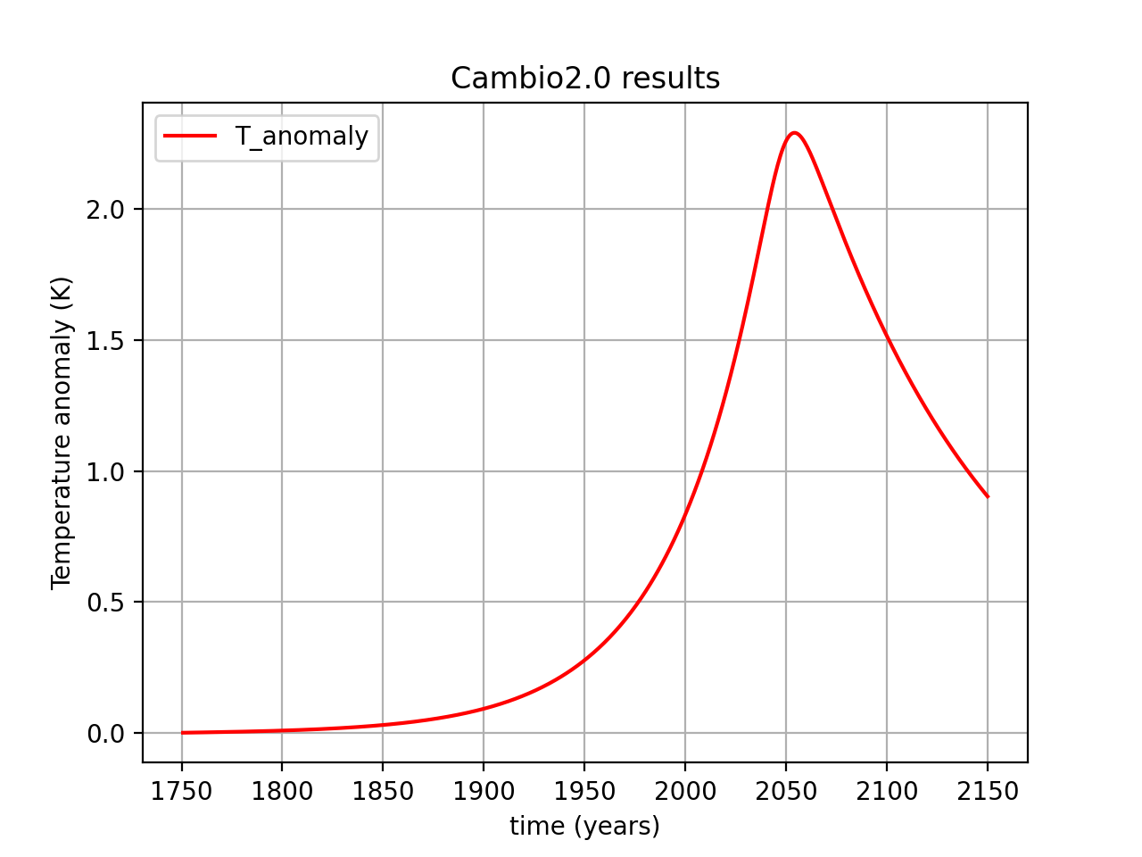
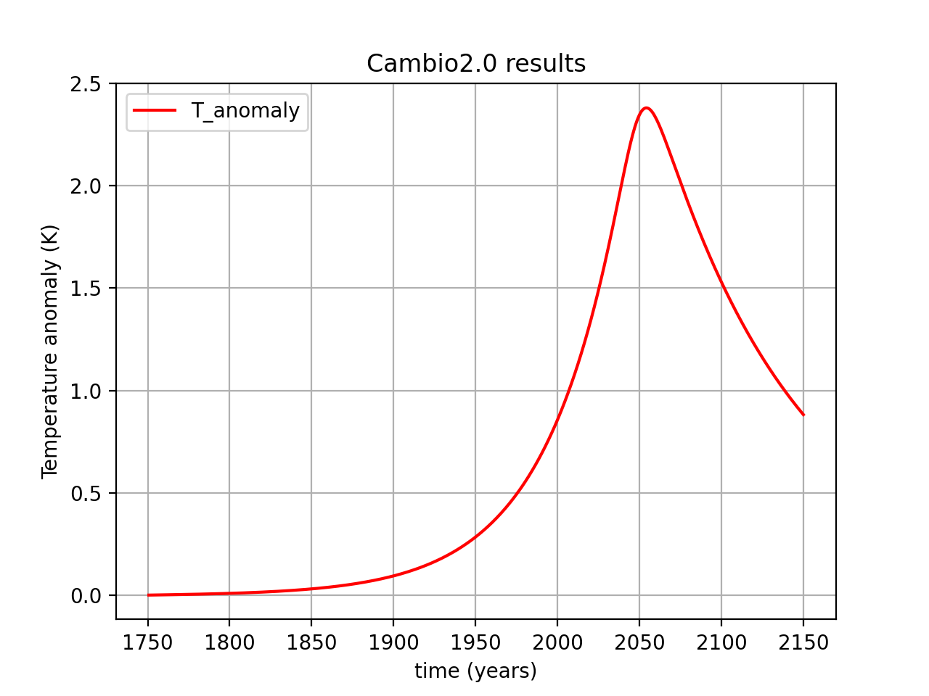
A peek at when the Henry effect is taken into account
Cold ocean
Warm ocean
Discuss this in small groups:
Which would you say are the old (Cambio1.0) results, and which are the new (Cambio2.0) results (and why)?

Slide 7
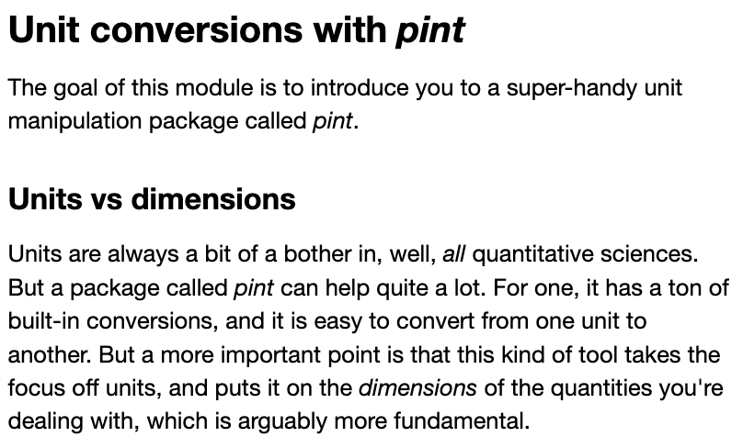


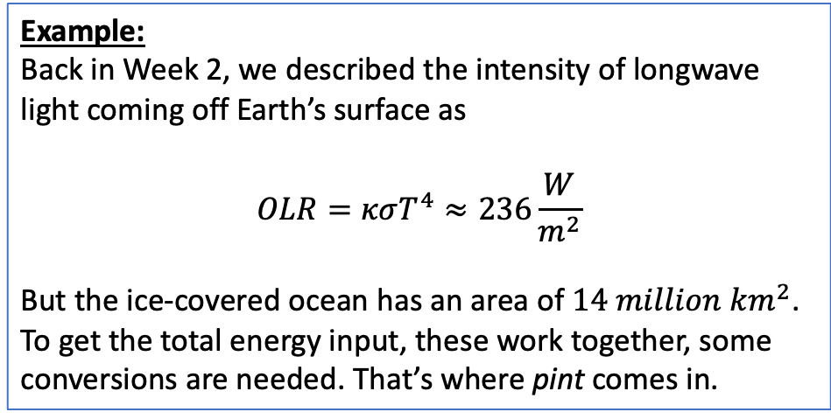
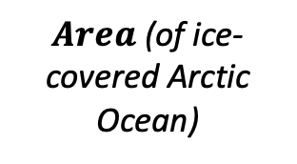

Next week’s Python work: what happens to the Arctic when summertime Arctic ice disappears
IceFreeArctic
$$I$$
clouds
$Area$ (of ice-covered Arctic Ocean)
$α$_{ice}
$α$_{ocean}
$$OLR$$
$Depth$
(of photic layer)
Example:
Back in Week 2, we described the intensity of longwave light coming off Earth’s surface as
$$OLR=κσT^{4}≈236\frac{W}{m^{2}}$$
But the ice-covered ocean has an area of $14 million km^{2}$. To get the total energy input, these work together, some conversions are needed. That’s where pint comes in.
Key ideas:
Depth, mass, and heat capacity of the Arctic Ocean’s photic layer
Solar insolation difference after Arctic sea ice is gone
Energy impact resulting when the very reflective ice cover gives way to open ocean. We’ll compare that energy impact to the energy released in a nuclear bomb.
Temperature impact

Slide 8
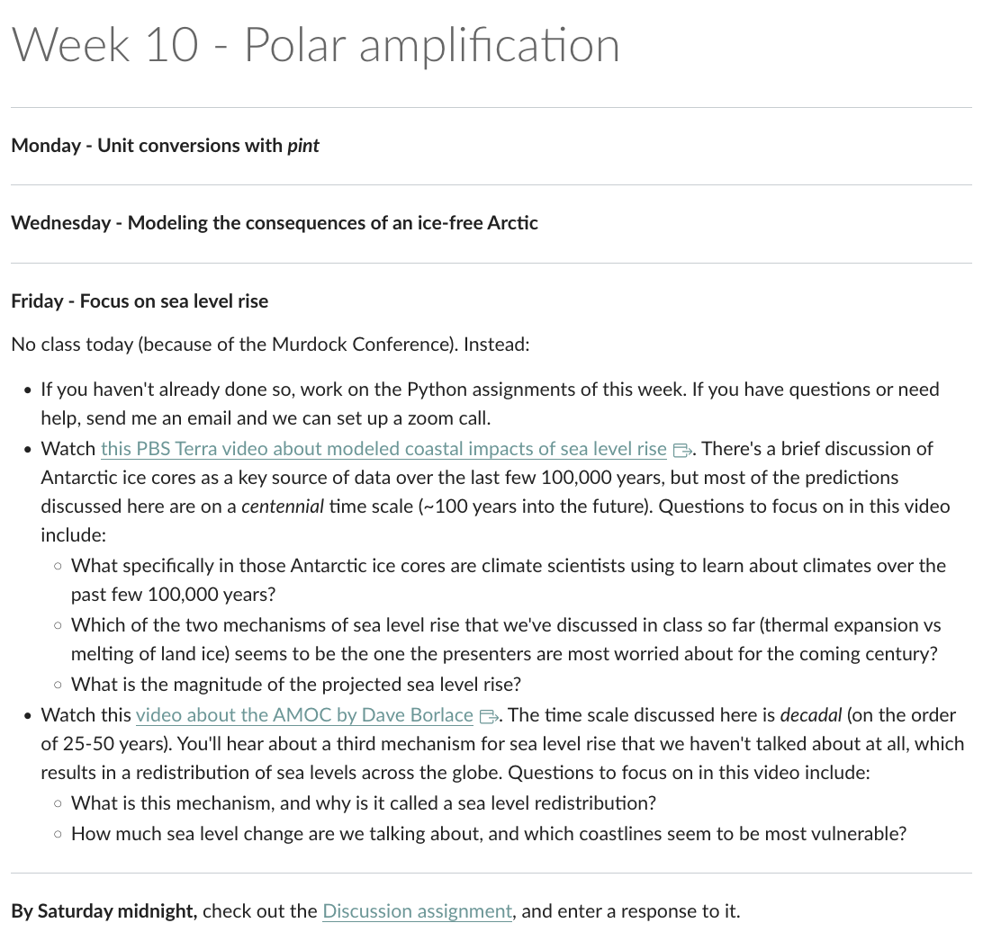
Next week

Slide 9
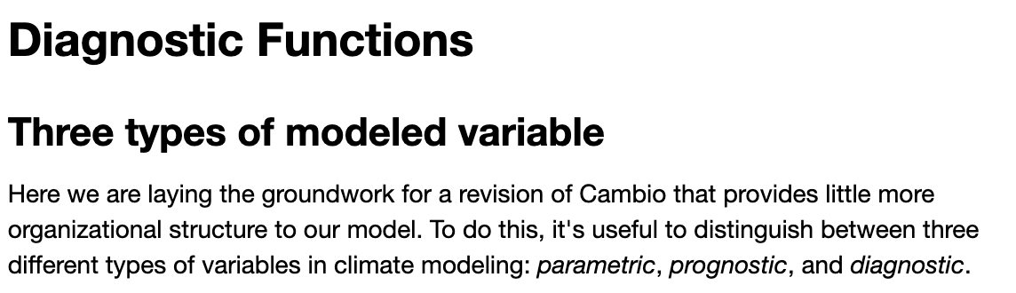
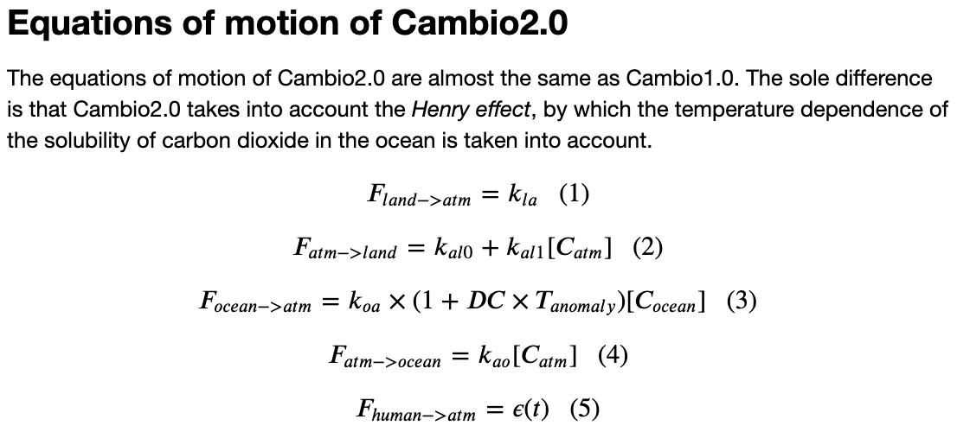
For today, however, let’s finish these up
Notes:
Predict the temperature if CO2 continues to rise. If we reduce CO2 emissions to zero.

